Slide 1
CHAPTER-1 CIVICS
THE CONSTITUTION AND THE NEED FOR LAWS

Slide 2
DESIGN A POSTER FOR THE SCHOOL DISPLAY BOARD SPREADING AWARENESS ON THE HARMFUL EFFECTS OF TOBACCO CONSUMPTION.
7/1/20

Slide 3
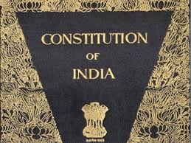
THE CONSTITUTION OF INDIA
Important document laying down the fundamental principles of a country.
It is also regarded as fundamental law of a country.
Indian Constitution came into effect on 26 January 1950
THE CONSTITUTION AND THE NEED FOR LAWS/GRADE-8/SOCIAL SCIENCE/Mrs. Sujatha/SOCIAL SCIENCE/SNS Academy

Slide 4
Importance of our constitution:
It contains valuable information about structure, organs , duties and responsibilities.
Regulates relation between various organs, citizen
and government.
System of checks and balances.
Guarantees rights to minorities.
Guarantees fundamental rights to citizens.

Slide 5
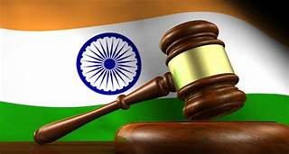
NEED FOR LAWS
Laws are meant for the welfare and the security of people.
They establish an egalitarian society
THE CONSTITUTION AND THE NEED FOR LAWS/GRADE-8/SOCIAL SCIENCE/Mrs. Sujatha/SOCIAL SCIENCE/SNS Academy

Slide 6
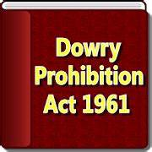
SOCIAL EVIL -DOWRY
It is the money or gift given to the groom and his family at the time of marriage.
To curb the practice of dowry, the government passed the Dowry prohibition act in 1961.
THE CONSTITUTION AND THE NEED FOR LAWS/GRADE-8/SOCIAL SCIENCE/Mrs. Sujatha/SOCIAL SCIENCE/SNS Academy

Slide 7
Social evil- Female Foeticide
This is also termed as PNDT Act.
The government passed the act in 1994.
Came into effect from 1 January 1996
Any violation of this act can result in imprisonment and fine.
THE CONSTITUTION AND THE NEED FOR LAWS/GRADE-8/SOCIAL SCIENCE/Mrs. Sujatha/SOCIAL SCIENCE/SNS Academy

Slide 8
Questions related to the above slides:
When did our constitution come into effect?
Explain the importance of our constitution.
3) Write a short note on ‘dowry’.
THE CONSTITUTION AND THE NEED FOR LAWS/GRADE-8/SOCIAL SCIENCE/Mrs. Sujatha/SOCIAL SCIENCE/SNS Academy

Slide 9
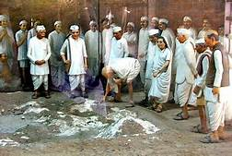
SALT SATYAGRAHA OF 1930
The British imposed tax on salt. Gandhiji launched Satyagraha against this tax.
In 1930, Gandhiji along with
his followers marched from
Sabarmati ashram to Dandi
and manufactured salt.
THE CONSTITUTION AND THE NEED FOR LAWS/GRADE-8/SOCIAL SCIENCE/Mrs. Sujatha/SOCIAL SCIENCE/SNS Academy

Slide 10
ANTI - LIQUOR MOVEMENT
Post Independence, an anti liquor movement was led by women in Andhra Pradesh.
They protested against the increase in the number of liquor shops.
THE CONSTITUTION AND THE NEED FOR LAWS/GRADE-8/SOCIAL SCIENCE/Mrs. Sujatha/SOCIAL SCIENCE/SNS Academy

Slide 11
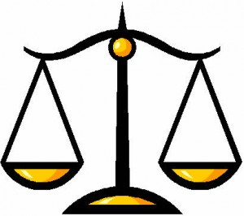
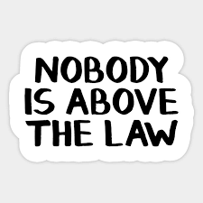
RULE OF LAW
THE CONSTITUTION AND THE NEED FOR LAWS/GRADE-8/SOCIAL SCIENCE/Mrs. Sujatha/SOCIAL SCIENCE/SNS Academy

Slide 12
QUESTIONS RELATED TO ABOVE SLIDES
1)Explain rule of law.
2)Describe in brief about the salt march.
THE CONSTITUTION AND THE NEED FOR LAWS/GRADE-8/SOCIAL SCIENCE/Mrs. Sujatha/SOCIAL SCIENCE/SNS Academy

Slide 13
REFERENCES
rsgr.in/sc0067
https://www.youtube.com/watch?v=UQLPat5oaN8
Thank you

